Slide 1
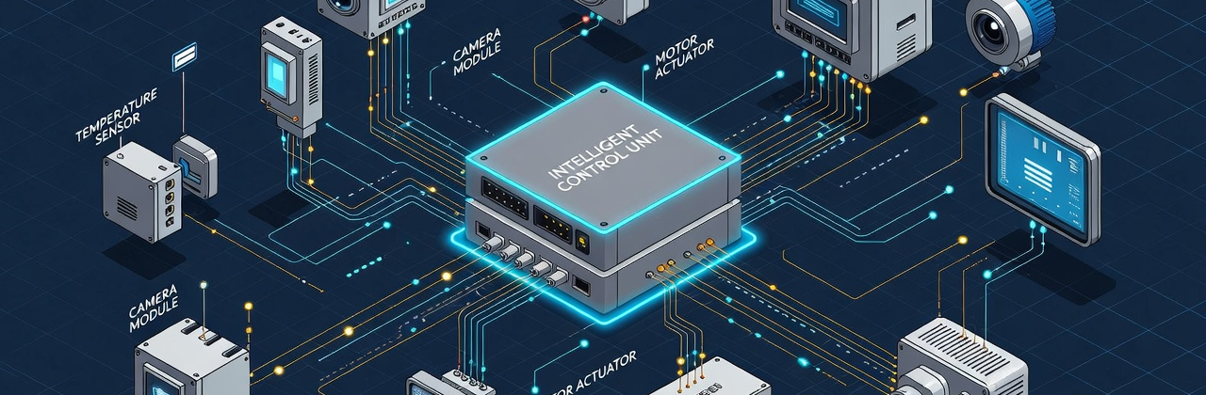
Science, Opportunities and Challenges 2026:
Intelligent Networked Control Systems
［Gifted Programme］
E2TEC023T
(Not-token required)
Emerging Technology Talk Series by YASHK
Dr Ling SHI
Professor at the Department of Electronic and Computer Engineering of The Hong Kong University of Science and Technology
Application Deadline
13 April 2026 12:00 noon
Intended Learning Outcomes
Upon completion of the gifted programme, gifted students should be able to:
Define an Intelligent Control System and describe its three main components: sensing (the senses), computation (the brain), and actuation (the action);
Explain how Wireless Sensor Networks act as the "nervous system" for large-scale environments, collecting data from places humans can't easily reach;
Identify the unique cybersecurity vulnerabilities that arise when control systems are connected to a network and describe a potential consequence of a cyberattack.

Slide 2




Gifted Programme Introduction
From self-driving cars that navigate traffic to smart grids that prevent blackouts, the world around us is being run by an invisible intelligence. This talk offers a rare look into the fascinating world of Intelligent Control Systems. We will explore how millions of tiny Wireless Sensors act as the "nervous system" for our cities, feeding data back to computers that make split-second decisions. But when you give the machines a network, you also create a target. We will dive into the high-stakes field of Control Systems Security, exploring how engineers defend power plants, water supplies, and autonomous vehicles from cyber threats.
Schedule
Session | Date | Time | Venue
1 | 2 May | 9:30 a.m. – 11:00 a.m. | Zoom meeting
Suitable for
Certificate
S1 – S6 HKAGE student members in 2025/26 school year.
Class size: 280
* First-come, first-served.
E-Certificate will be awarded to participants who have attended the talk.
Remark
Starting from the 2023/24 school year, after the first review period, ALL student members must complete the following requirements in each school year in order to maintain their membership:
Attend One Talk; AND
Participate in One programme or activity of any kind
Medium of Instruction
Putonghua
This talk is one of the items in the five domains of the Holistic Talk Series. The objective is to facilitate the all-round development of student’ gifted potential.
Emerging Technology Talk Series
by YASHK
National Security Talk Series
Understanding the meaning of National Security, enhances students' sense of national identity.
Scientists introduce eye-opening emerging technology to enhance students’ motivation to learn.
Ignite Life Talk Series
Celebrities share their life-changing moments to enhance students’ aspirations for life.
Trendy Academic
Talk Series
Future Insight Talk Series
Introduce trendy topics to widen the students’ horizons.
Professionals share insights about the latest trends in their industry to help students plan their future.

