Slide 1
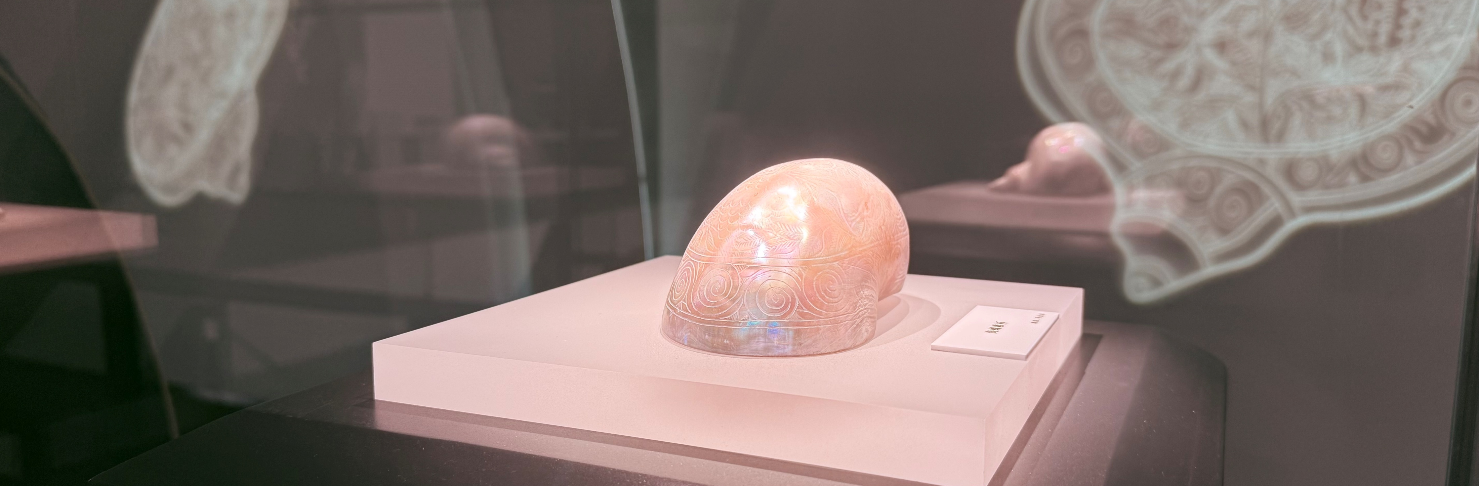
Trade & Cultural Exchange Along Maritime Silk Road
A2ACH003T
［Gifted Programme］
(Not-token required)
Trendy Academic Talk Series
Archaeology Talk (Level II)
Institute of Hong Kong Underwater Archaeology Research
Application Deadline
27 Mar 2026
12:00 noon
Intended Learning Outcomes
Upon completion of the gifted programme, gifted students should be able to:
describe Maritime trade and Maritime Silk Road;
anlyse the cultural and historical significances of ports; and
enhance understanding of Hong Kong and the Maritime Silk Road;

Slide 2




Gifted Programme Introduction
This talk takes students on an engaging journey along the Maritime Silk Road, exploring how maritime trade has connected regions, people and cultures across time. Through examining key ports, participants will gain insights into their economic importance and cultural significance, with a particular focus on Hong Kong’s role in this historic and contemporary network. By the end of the programme, students will be able to describe maritime trade and the Maritime Silk Road, analyse the significance of major ports, and develop a deeper understanding of Hong Kong’s position and development within this global maritime system.
Schedule
Session | Date | Time | Venue
1 | 11 Apr | 9:30a.m. – 12:30 p.m. | HKAGE
Suitable for
Certificate
S1 – S6 HKAGE student members in 2025/26 school year.
Class size: 80
* First-come, first-served.
E-Certificate will be awarded to participants who have attended the talk.
Remark
Starting from the 2023/24 school year, after the first review period, ALL student members must complete the following requirements in each school year in order to maintain their membership:
Attend One Talk; AND
Participate in One programme or activity of any kind
Medium of Instruction
Cantonese
This talk is one of the items in the five domains of the Holistic Talk Series. The objective is to facilitate the all-round development of student’ gifted potential.
Emerging Technology Talk Series
by YASHK
National Security Talk Series
Understanding the meaning of National Security, enhances students' sense of national identity.
Scientists introduce eye-opening emerging technology to enhance students’ motivation to learn.
Ignite Life Talk Series
Celebrities share their life-changing moments to enhance students’ aspirations for life.
Trendy Academic
Talk Series
Future Insight Talk Series
Introduce trendy topics to widen the students’ horizons.
Professionals share insights about the latest trends in their industry to help students plan their future.

