Slide 1
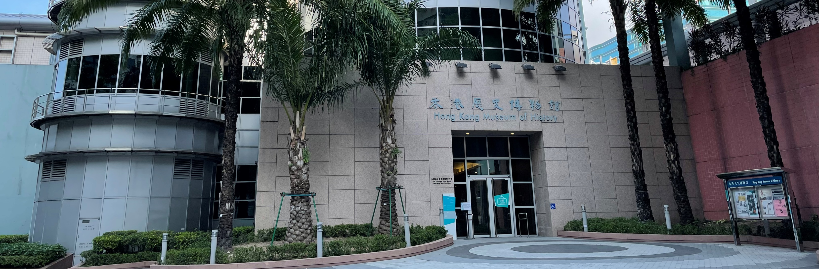
Future Curator Training 2023
E1HUM001C
(Token- required)
Museum Studies Course (Level I)
Assistant Curators, Hong Kong Museum of History
and guest speakers
Application Deadline
17 Jul 2023
12:00 noon
Result Release
19 Jul 2023
Intended Learning Outcomes
Upon completion of the programme, participants should be able to:
explain the historical and cultural meaning and functions of a museum;
enrich their knowledge of heritage, materials analysis and management, creativity and communication;
explain the scope of duties, the necessary expertise and knowledge of a curator;
acquire an insight to plan their future after meeting with people in different museum related areas.
If student members withdraw from the programme after the Application Deadline, the token will be deducted.

Slide 2
Introduction
The Future Curator Training programme is designed for secondary student members who are interested in museum work, history and culture. The programme aims to familiarise students with the museum’s functions of collection, conservation, exhibition and education as well as the duties of museum curators through talks, visits, workshops, project-based learning and sharing sessions with curators. Through the theme-based project designed specifically for the year, students’ knowledge about local history and culture will also be enhanced.
This programme is co-organised with the Hong Kong Museum of History.
Schedule
Session | Date | Time | Activities | Venue
1 | 7 Aug (Mon) | 9:30 a.m. – 12:30 p.m. | What is “museum”？ Indoor visit: “Recreating a Classic: The Best Features of The Hong Kong Story” | Hong Kong Museum of History¹
2 | 7 Aug (Mon) | 2:30 p.m. – 3:30 p.m. | Outdoor visit⁺: Heritage of Mei Ho House | Heritage of Mei Ho House²
 |  | 3:30 p.m. – 4:30 p.m. | Outdoor visit⁺: The Jockey Club Creative Arts Centre | The Jockey Club Creative Arts Centre³
3 | 8 Aug (Tue) | 9:30 a.m. – 11:45 a.m. | Collection Management Workshop and Sharing Visit Resource Centre Introduction to group presentation | Hong Kong Museum of History¹
4 | 8 Aug (Tue) | 2:00 p.m. – 4:00 p.m. | Outdoor visit⁺: Ping Shan Tang Clan Gallery cum Heritage Trail# | Ping Shan Tang Clan Gallery cum Heritage Trail Visitors Centre⁴
5 | 9 Aug (Wed) | 9:30 a.m. – 12:30 p.m. | Visit conservation laboratory Conservation Workshop | Hong Kong Museum of History¹
6 | 9 Aug (Wed) | 2:30 p.m. –4:30 p.m. | Outdoor visit⁺: Wan Chai Heritage Tour@ | Wan Chai District
7 | 14 Aug (Mon) | 10:00 a.m. –12:00 noon | Group Presentation Graduation Ceremony | Hong Kong Museum of History¹
⁺ HKAGE will arrange coach service to pick up participants from the Hong Kong Museum of History to the outdoor visit sites. We will lead them to the nearby MTR Station for dismissal. In case of inclement weather, the arrangements for outdoor visits will be provisional and subject to changes. Details will be explained in the first session.
# The route of Heritage Trail includes Ching Shu Hin, Kun Ting Study Hall, Yu Kiu Ancestral Hall and Tang Ancestral Hall ONLY.
@ The route of Wan Chai Heritage Tour includes Yuk Hui Temple (Pak Tai Temple), the Blue House, Old Wanchai Market Building, Old Wan Chai Post Office, Woo Cheong Pawn Shop etc.

Slide 3
Schedule (cont.)
¹ Hong Kong Museum of History: 100 Chatham Road South, Tsim Sha Tsui, Kowloon (map)
² Heritage of Mei Ho House: Block 41, Shek Kip Mei Estate, 70 Berwick Street, Sham Shui Po, Kowloon (map)
³ The Jockey Club Creative Arts Centre: 30 Pak Tin Street, Shek Kip Mei, Kowloon (map)
⁴ Ping Shan Tang Clan Gallery cum Heritage Trail Visitors Centre: Hang Tau Tsuen, Ping Shan, Yuen Long, N.T. (map)
Target Participants
Medium of Instruction
S1 – S6 HKAGE student members in 2022/23 school year only
(Must be new applicants who have not joined the “Future Curator Training” before)
Class size: 30
Student members would be selected randomly by the computer system. The decision of HKAGE on the result of the selection should be final.
Cantonese with Cantonese handouts
Certificate
E-Certificate will be awarded to participants who have:
attended ALL sessions; AND
completed all the assignments with satisfactory performance
Pre-requisite
No special prerequisites are needed. Sections of the outdoor visits certain efforts will be required. Participants should assess and consider their own health conditions before making application for this programme.
Notes:
shall ensure their own physical condition is suitable for joining the Event
In case of inclement weather

